Slide 1

Battlegrounds class and faction advantage
Jolene Butt
5/30/2020
Bellevue University
DSC530-T301 Data Exploration and Analysis (2205-1)

Slide 2
“World of Warcraft isn’t just about the destination. It’s a hobby that, if you enjoy it, may well end up returning to for hundreds of hours over the course of years” (Messner, 2020).
Out of all the aspects that the online role-playing game World of Warcraft has to offer we will be focusing on the Battlegrounds where the Factions the player chooses fights agents the other in order to win and bring honor to their side.

Slide 3

Dataset and variables
Kaggle: World of Warcraft Battlegrounds
Faction: faction of the player (Horde or Alliance)
Class: class of the player (warrior, paladin, hunter, rogue, priest, death knight, shaman, mage, warlock, monk, druid, demon hunter).
Damage: damage done by the player.
Healed: healing done by the player.
Win: 1 if the player won.

Slide 4

Which side are you on?
What class should you play?

Slide 5

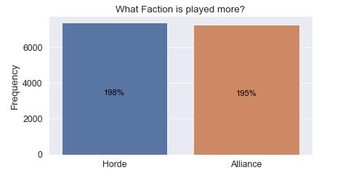
Both sides are equally played but are they equally matched?

Slide 6
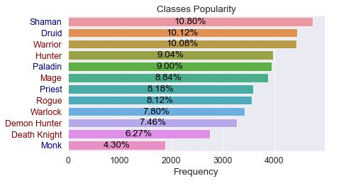
Do you pick the most popular character played?

Slide 7
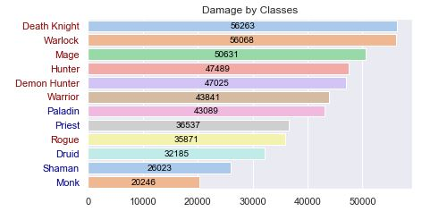
The ones that causes the most damage?

Slide 8
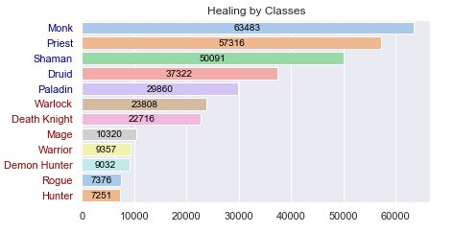
The one that heals the most?

Slide 9
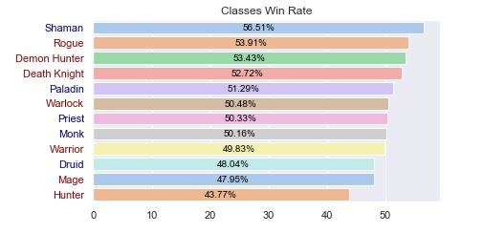
Or do you pick the one that wins the most?

Slide 10
Let us look deeper and see
What class performers overall the best

Slide 11

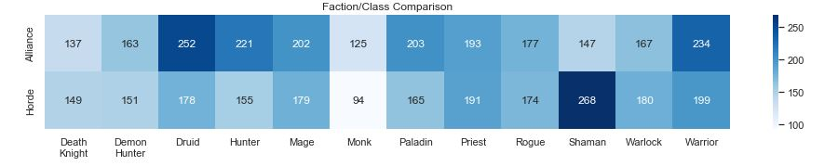
Horde
Alliance

Slide 12
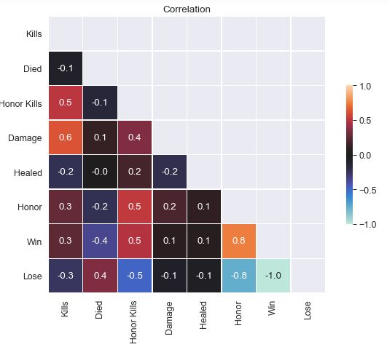
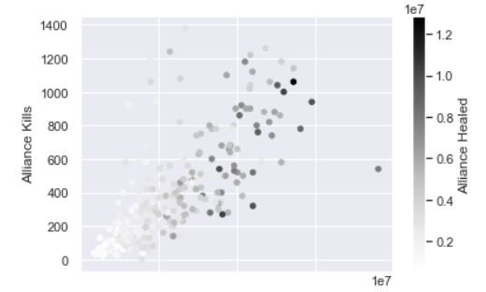
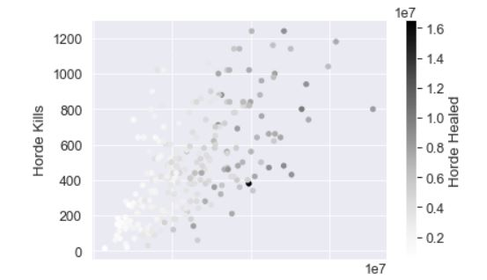

Slide 13
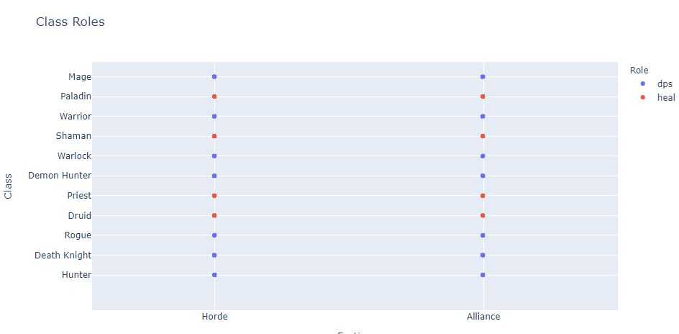
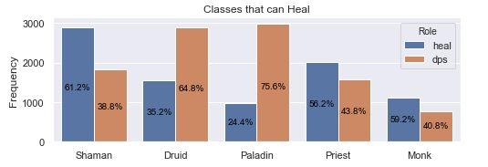
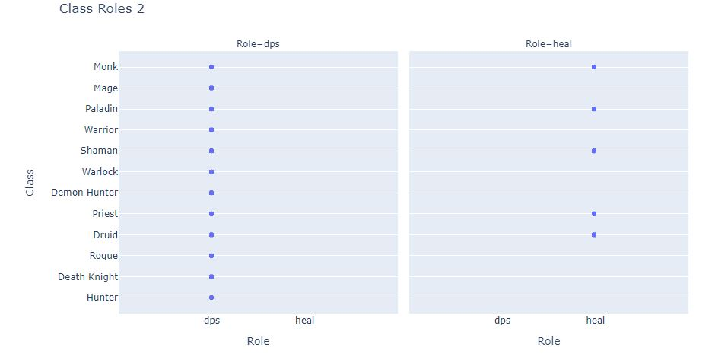
All classes can cause damage all classes can heal but not all classes can be a healer

Slide 14
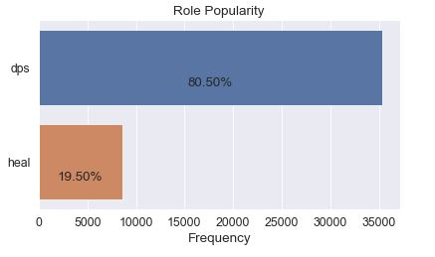

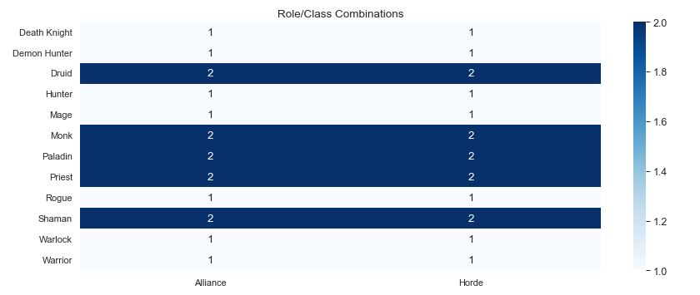
The Battlegrounds require more players that can supply damage then those that heal.

Slide 15
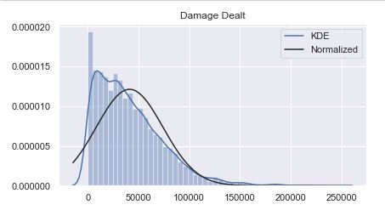

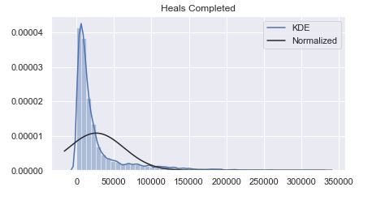
More Damage is Dealt then Heals are complete
Due to having more players in the role to provide damage then to provide heals

Slide 16


Equally Played and Equally Matched, there is no advantages for the Faction you choose

Slide 17

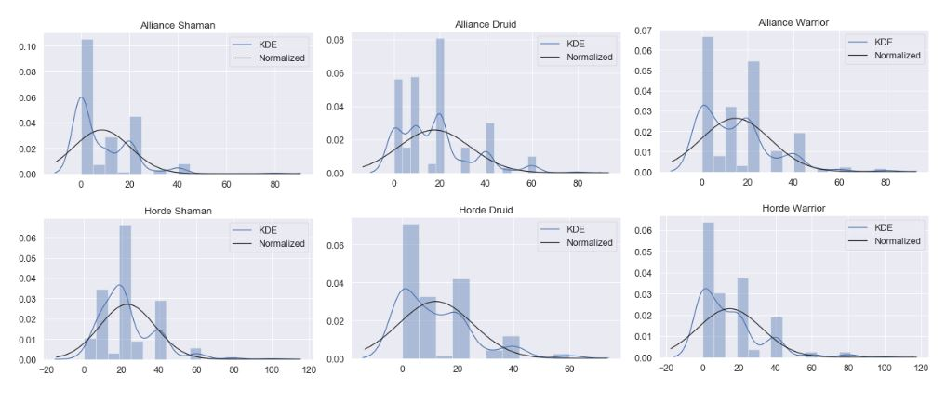
The top three classes by popularity

Slide 18
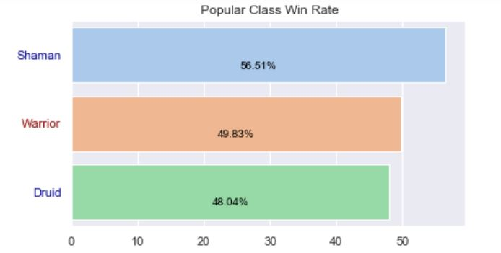
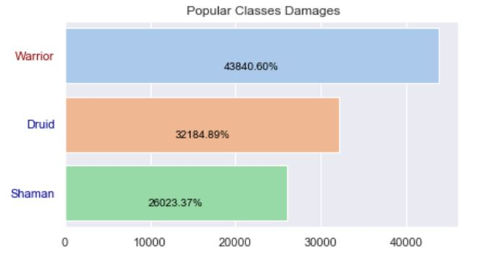
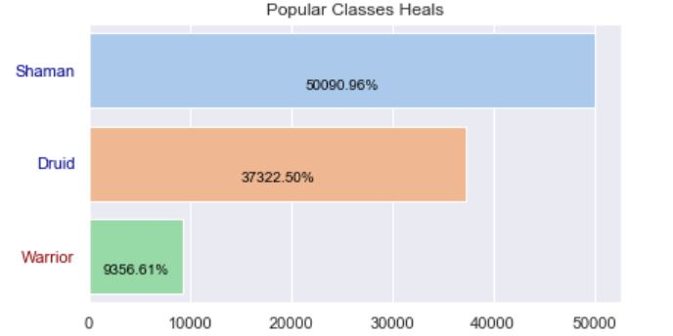

Slide 19
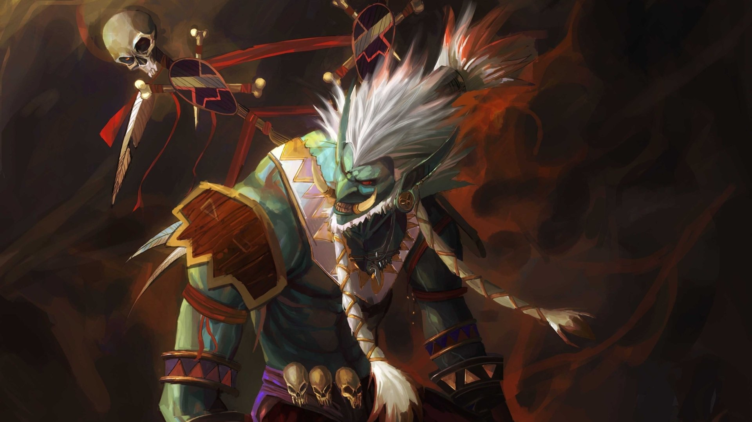
Out of those classes played by popularity the Shaman performs better then others

Slide 20

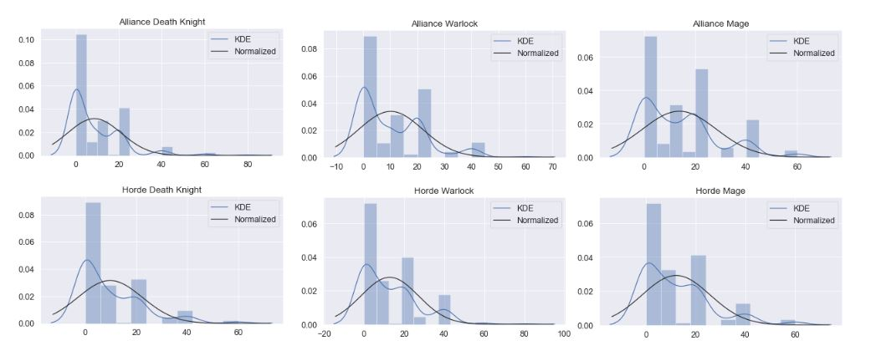
The top three classes by
Damage Per Second

Slide 21
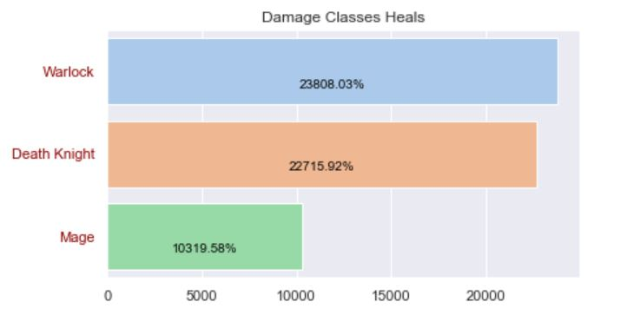
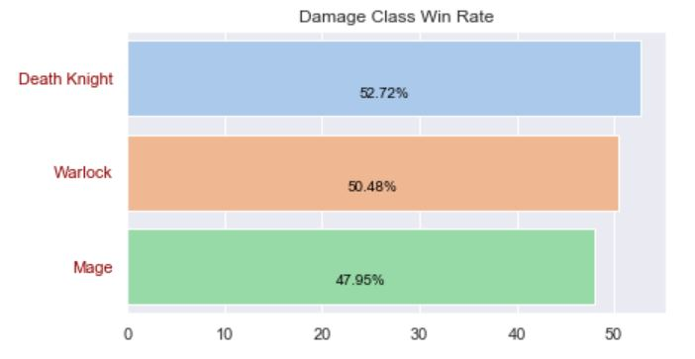
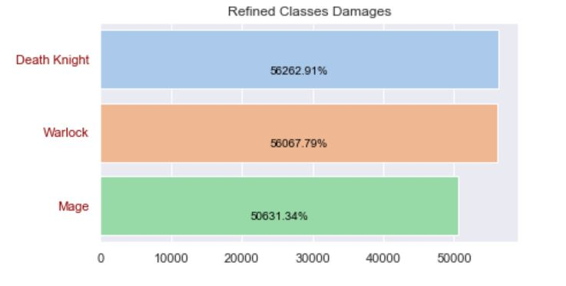

Slide 22

The Damage the Death Knight causes in the Battlegrounds bring them to the top in this ranking

Slide 23

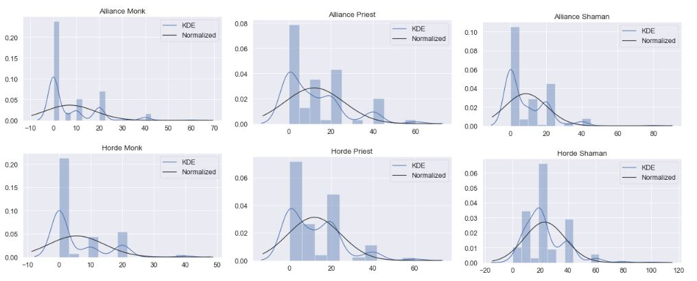
The top three classes of Healers

Slide 24
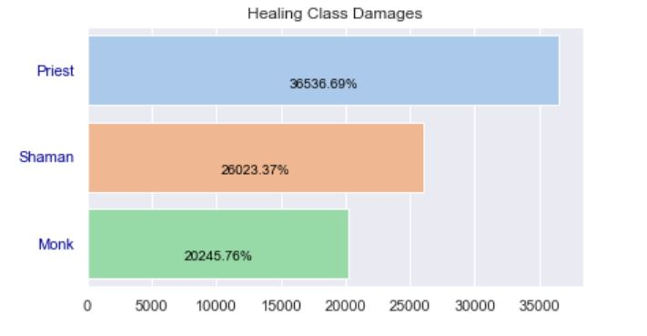

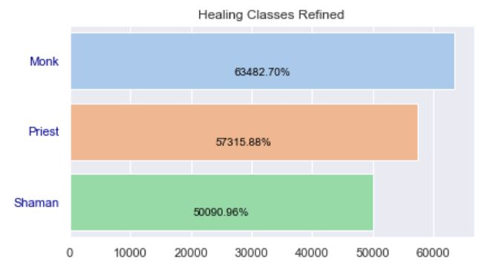
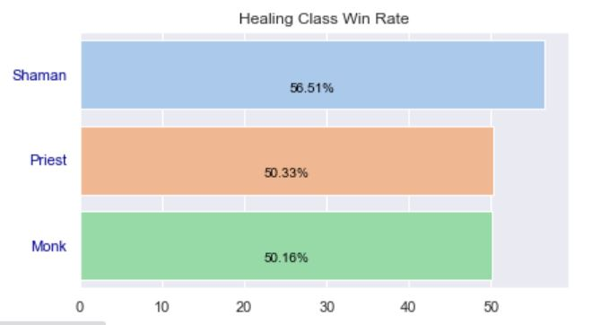

Slide 25

It was close but the Priest has better overall performance than the other two of the top healers.

Slide 26

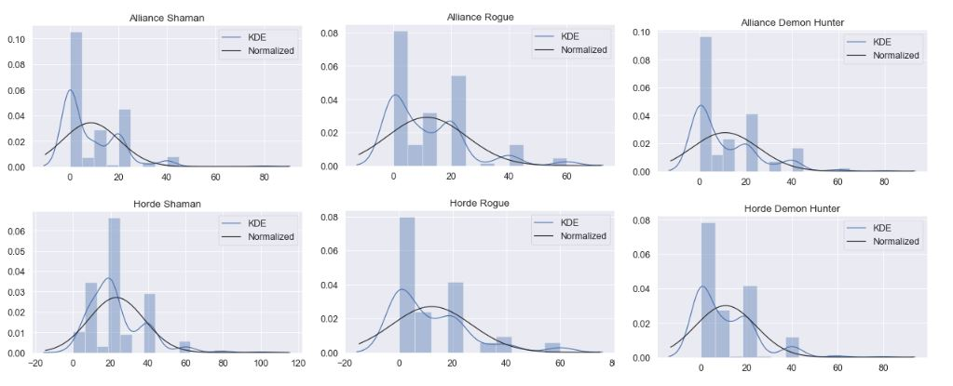
The top three classes by wins

Slide 27
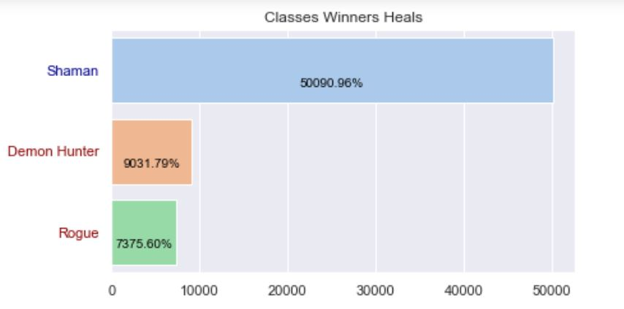
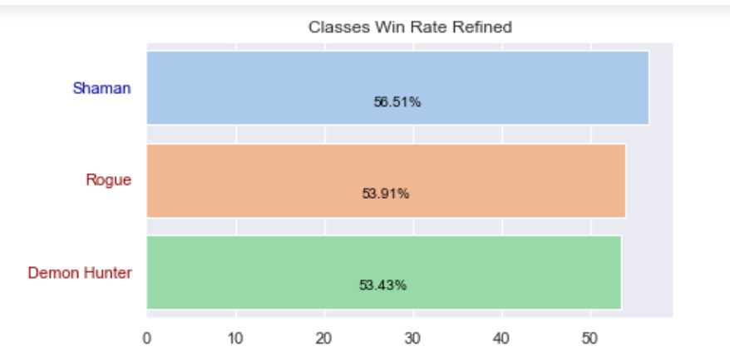
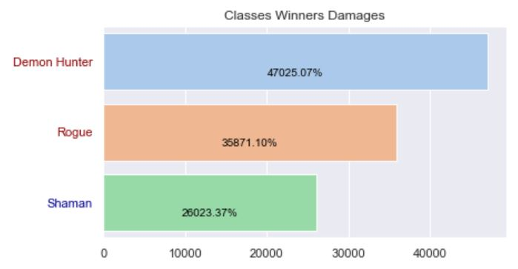

Slide 28
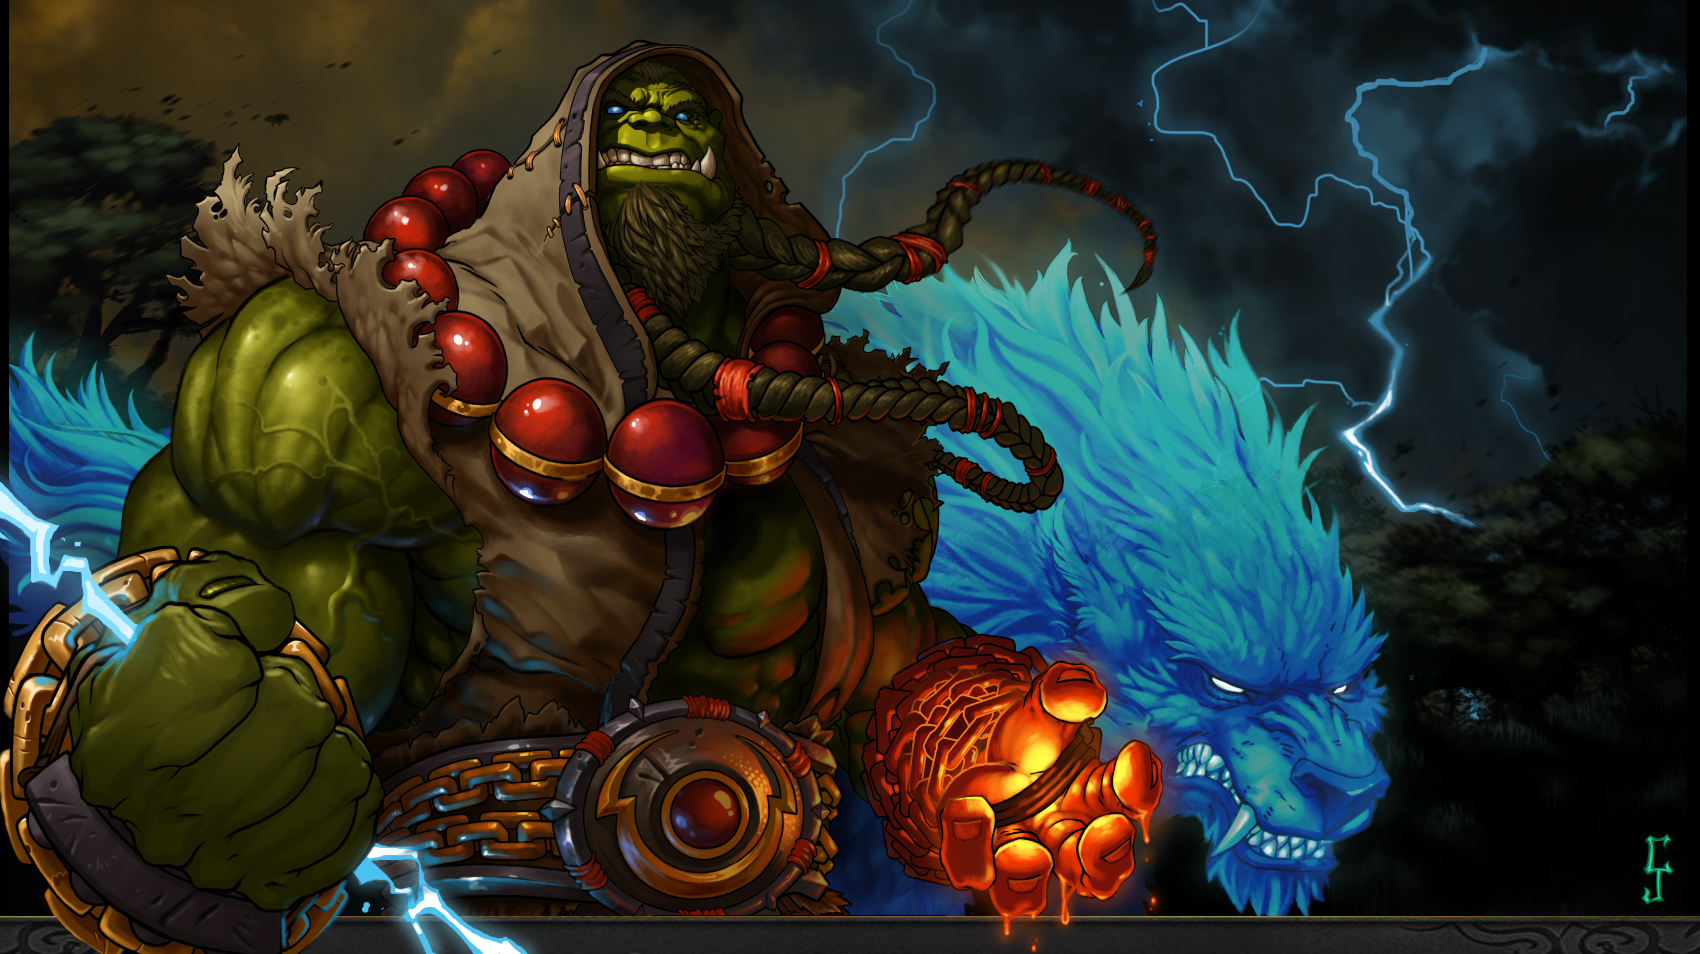
The Shaman
Wins Again!

Slide 29

The Top of the Top!
The Shaman (x 2)
The Priest
The Death Knight

Slide 30

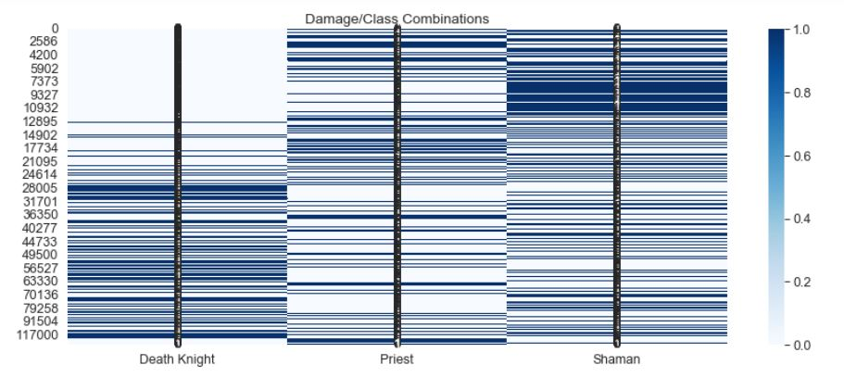

Slide 31
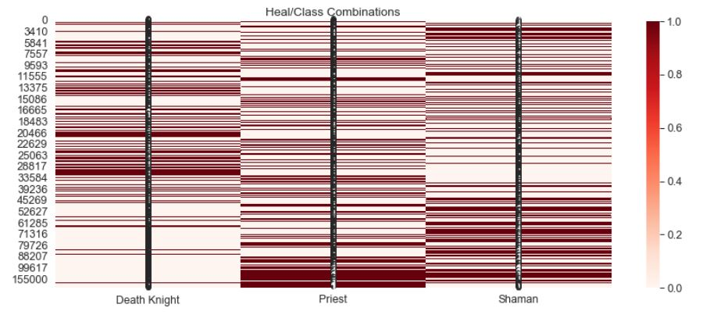

Slide 32
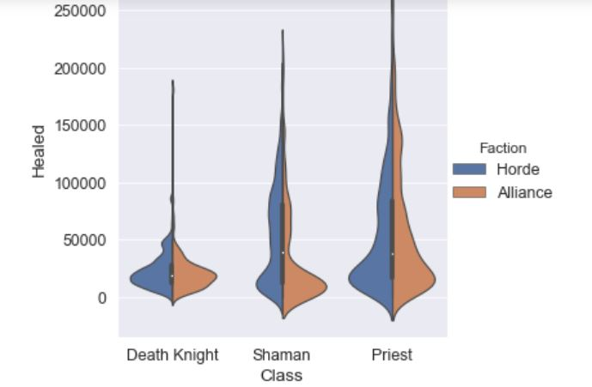
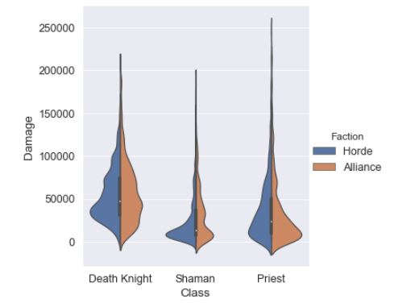
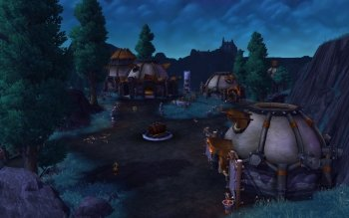

Slide 33


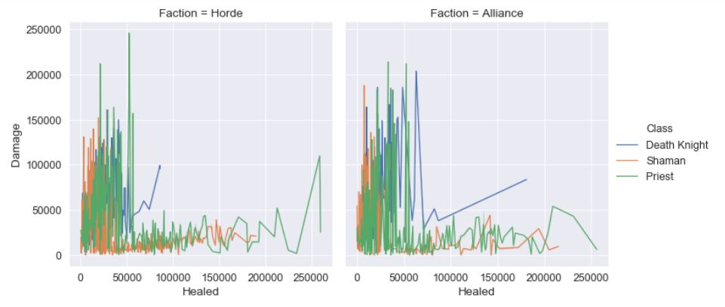


Slide 34

The Death Knight is a good Choice for those who want To focus on causing Havoc and deal some damage to the other side.

Slide 35
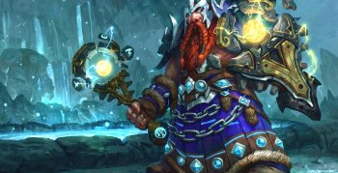
Even though the Shaman was top of two of the four categories,
This class runs the middle of the road when it comes to being on the top of this game.

Slide 36

The Priest is Tops when it comes to Healing as well as constantly performing well as a damage dealer.
This makes the Priest the most well-rounded class to play in a Battleground on World of Warcraft.

Slide 37

References
Messner, S. (2020, April 16). World of Warcraft Beginner's guide: How
to get into WoW and WoW Classic. Retrieved from PCGamer.com:
https://www.pcgamer.com/how-to-get-into-world-of-warcraft/
World of Warcraft Battlegrounds. (n.d.). Retrieved from kaggle.com:
https://www.kaggle.com/cblesa/world-of-warcraft-battlegrounds
Images retrieved from
https://worldofwarcraft.com/en-us/battle-for-azeroth/media#tab=screenshot
https://wall.alphacoders.com

